Slide 1


Photo placeholder
(jobsite, shovel, excavation)
Connecting Minnesota for Safe Digging
Gopher State One Call (GSOC) is Minnesota’s one call notification system.
GSOC's implementation roadmap for improving the notification process and improving damage prevention.
Before you dig, click or call.
Kelly Connolly • Chief Operations Officer
Notes:
Replace LOGO box with the official GSOC logo (white version on green). Replace the photo placeholder with a jobsite image.

Slide 2

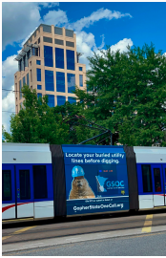
Before you dig, call
Gopher State One Call
By the Numbers
912,290
Tickets processed (2025)
3.7%
Average increase YTD over 2025
85.9% >>87.7%
Percent online YTD 2025 >>> YTD in 2026

Slide 3
Implementing New Ways to Make Digging Safer and More Efficient
Legislative changes, technology advances Drive New Tools at GSOC

Slide 4
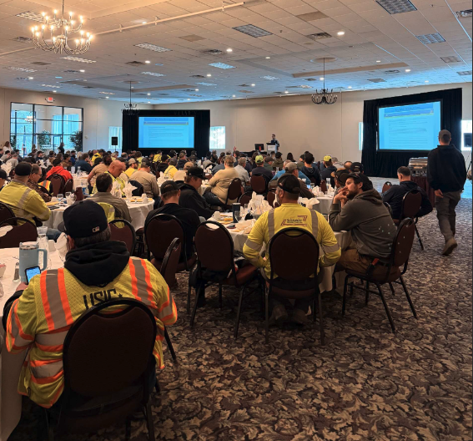
Before you dig, call
Gopher State One Call
Implementation Road Map
1 Automated Marking Instructions
Photo placeholder
2 Electronic White Lining
3 Ticket Talk
4 Mandatory Electronic Positive Response
5 Site X-Ray, powered by FuzionView​

Slide 5
Before you dig, call
Gopher State One Call
New in 2025-2026
Automated Marking Instructions
Electronic White Lining
Mandatory Electronic Positive Response
Providing a clear, consistent language across tickets to make it easier for operators and locators to mark facilities.
Beginning in January 2026, excavators may opt to provide electronic markings, if they provide the same level of information.
Beginning August 1, operators must now provide an electronic positive response.

Slide 6
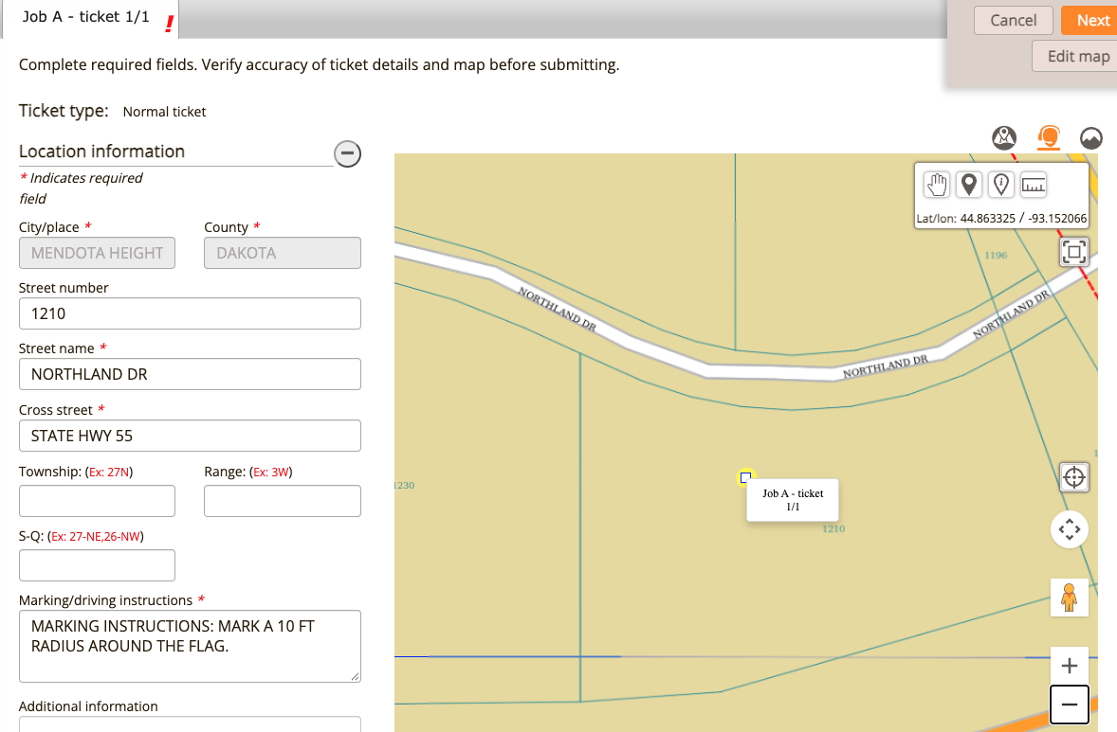
Before you dig, call
Gopher State One Call
Automated Marking Instructions
Using the four key tools in ITIC will auto generate marking instructions with a clear, consistent language.
For tickets that have no changes to the instructions, they are released directly to FOs.
With changes, or with using the manually drawn polygon feature, tickets reviewed by GSOC before finalized.
Implemented to make it easier to comply with electronic white lining.
Key takeaway: Using automated marking instructions will, in many cases, provide enough information for operators and locators.

Slide 7
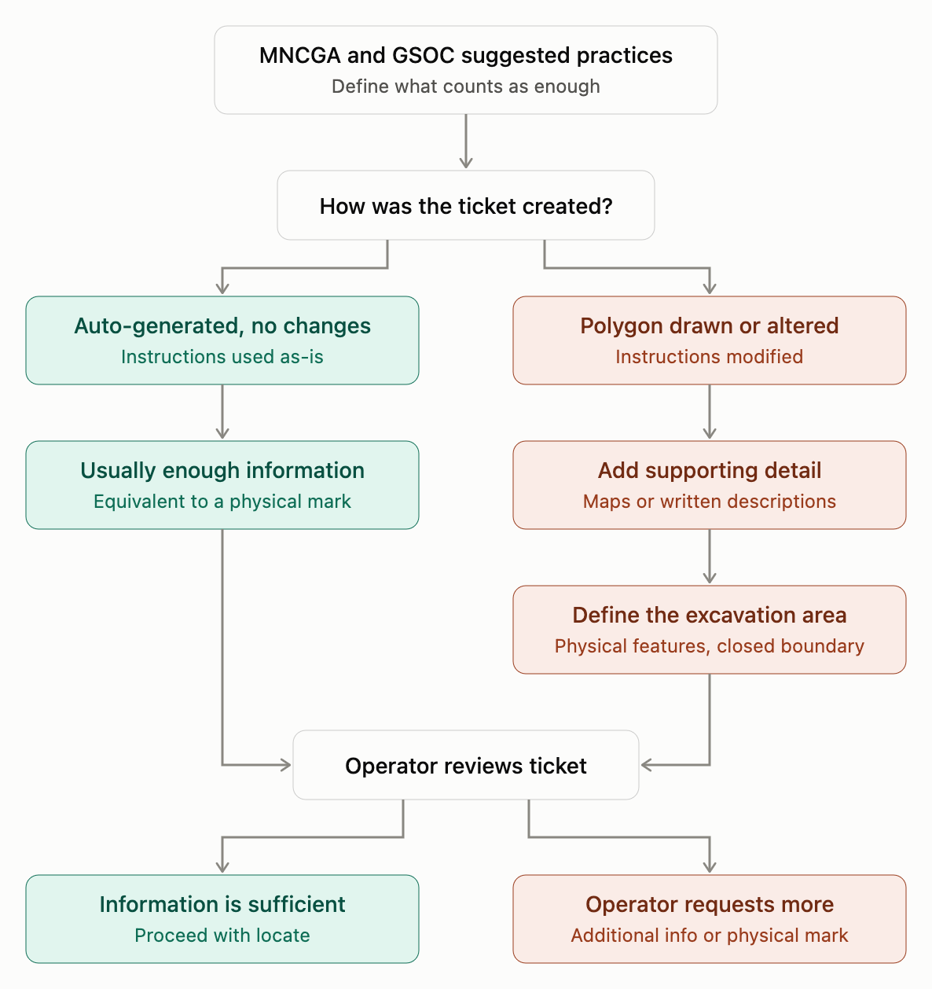
Before you dig, call
Gopher State One Call
Electronic White Lining
What does it mean to provide the same amount of information as a physical mark?
MNCGA and GSOC issued suggested practices.
Using tools with auto generated instructions (with no changes) will in many cases, provide enough information.
Provide additional information for manually drawn polygon or altered tickets (maps or descriptions with physical features and a defined, closed boundary.
Operators may request additional info or a physical mark.
Photo placeholder
Key takeaway: Providing additional information for these tickets will help operators and locators mark their facilities and avoid a request for a physical mark.

Slide 8
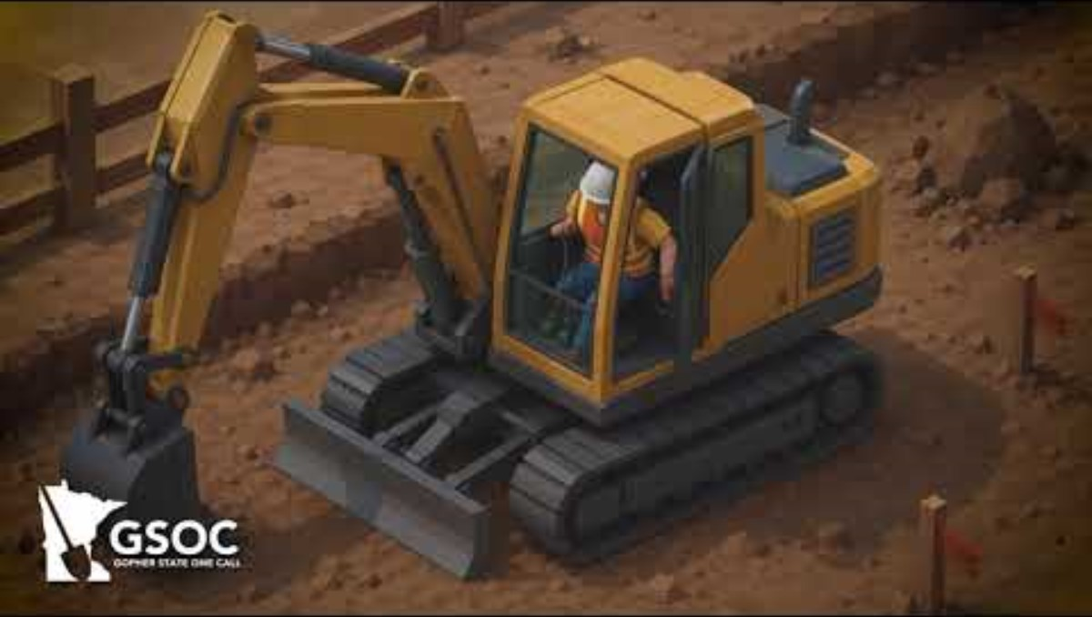
Before you dig, call
Gopher State One Call
Ticket Talk – two-way communication within the ticket
Ticket Talk is a new tool for excavators, operators and locators to share information.
Share supplemental information. It provides another way to reach each other while also adding that information to the ticket.
Get messages by clicking on the ticket link, My Tickets, or Locator Tickets. (GSOC can work with TMS to implement!).

Slide 9

Before you dig, call
Gopher State One Call
Mandatory Electronic Positive Response (EPR)
Starting August 1, operators must provide positive response via iSite.
For those without internet access, GSOC can arrange for you to call in the response.

Slide 10
Before you dig, call
Gopher State One Call
Coming in 2027
Site X-Ray, powered by FuzionView
Project Coordination
Field Issues Tool
GSOC's new tool that allows operators to secure share data related to a ticket with approved end users.
A potential new tool allowing excavators to be alerted if there is an overlapping project.
A new potential function to notify GSOC of field issues, like a bad contact number.

Slide 11

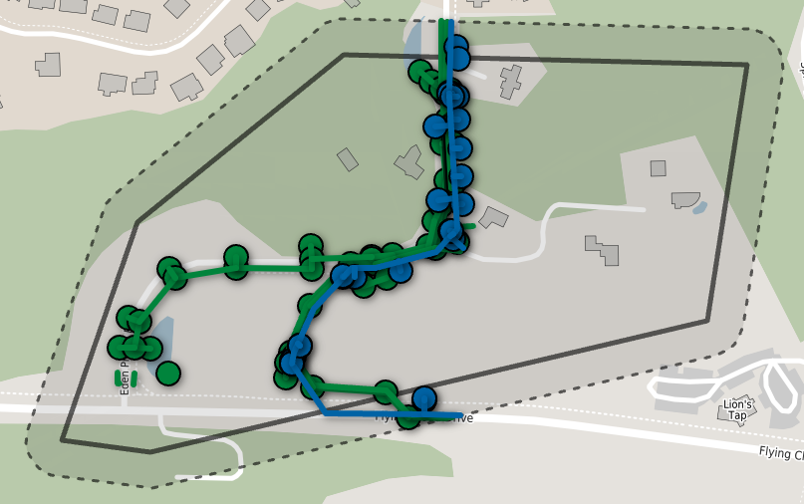
Before you dig, call
Gopher State One Call
Site X-Ray, powered by FuzionView
For the first time and at no additional cost to users, facility operators can securely share data related to a specific one-call ticket.
Once a ticket comes in, a message is sent to the utility GIS database to collect the latest data for that ticket only.
The data is available for the life of the ticket.
Operators have full control through data administration and sector-specific user agreements.

Slide 12
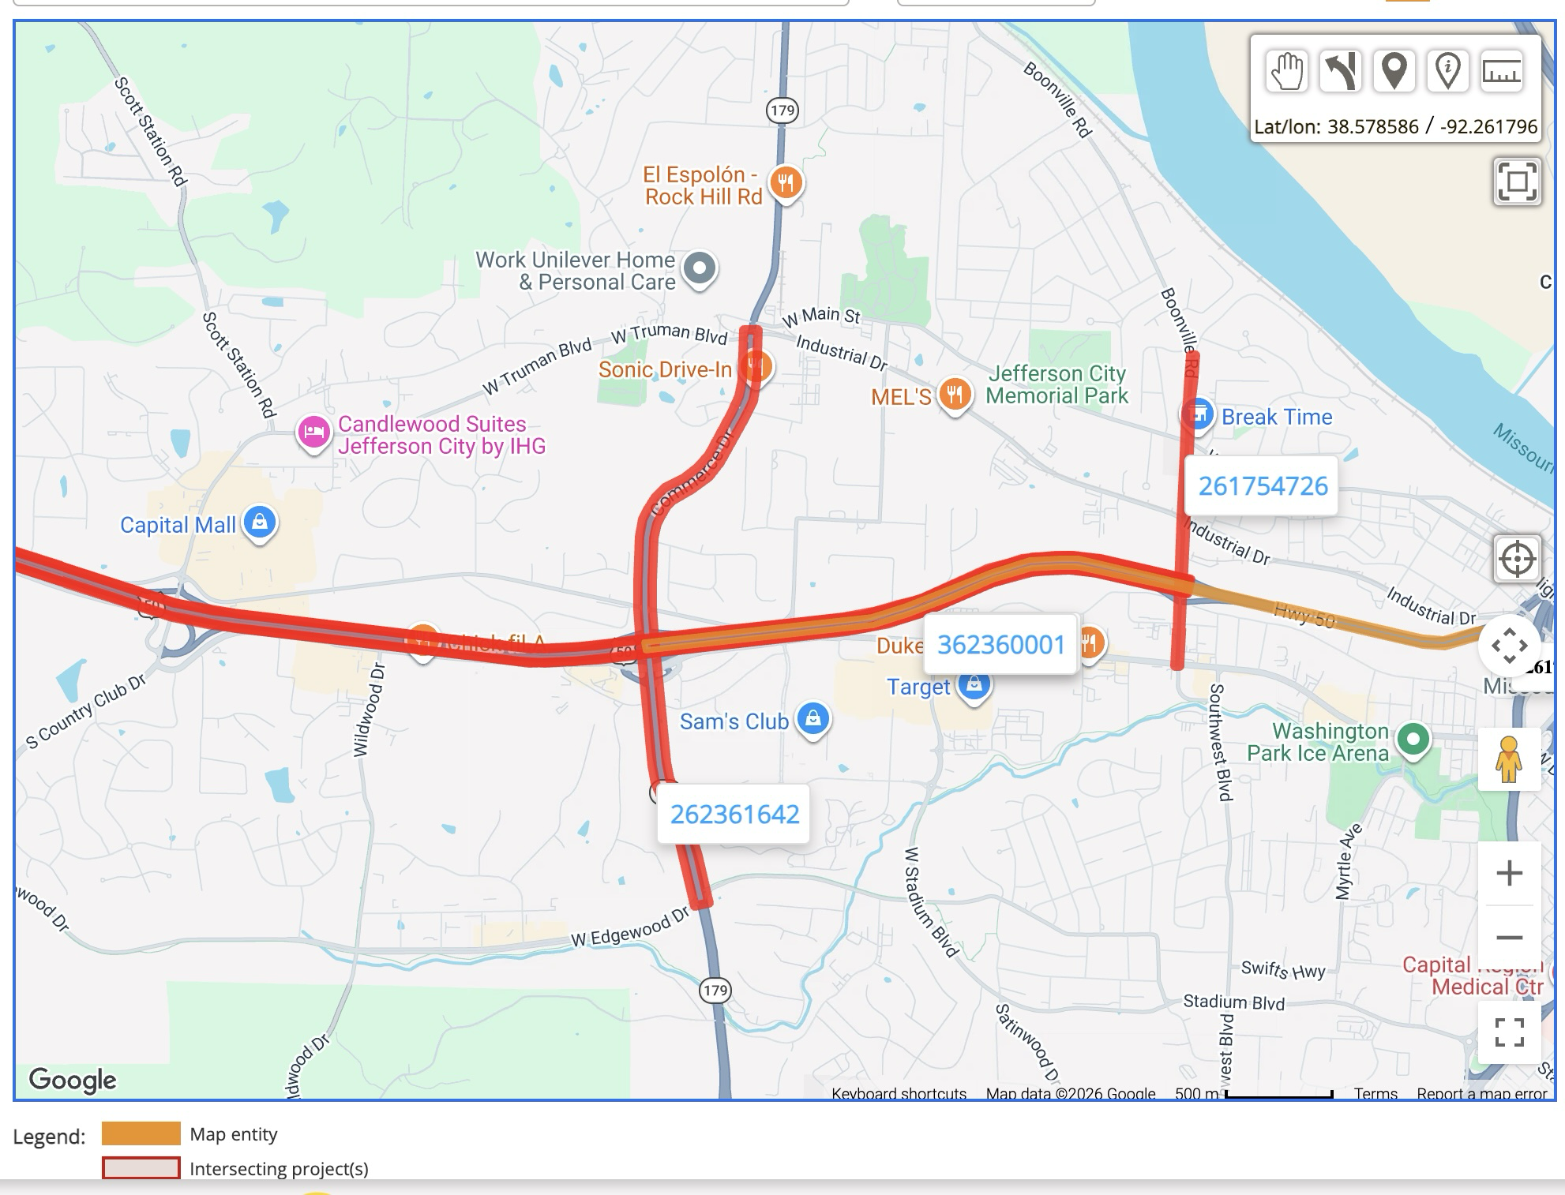
Before you dig, call
Gopher State One Call
Project Coordination
GSOC is exploring the use of a new tool to help better coordinate projects.
When excavators file a project ticket, they would be notified if another project overlaps.
Contact for the overlapping project will also receive notification.
The goal is to provide a space for excavators to better understand what is happening near their planned projects and hopefully increase communication and coordination down the line.

Slide 13
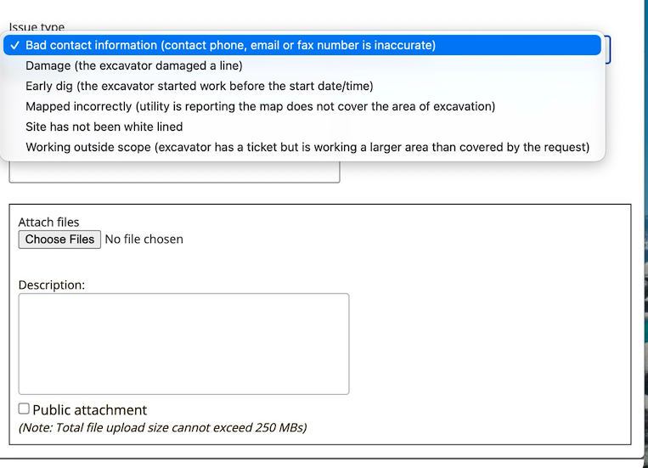
Before you dig, call
Gopher State One Call
Field Issues Tool
GSOC is looking at a new tool that would allow operators and excavators to provide a report through ITIC on a pre-selected set of issues.
Issues would be custom to Minnesota, but could include bad contact information, site has not been white lined or mapped incorrectly.
This would allow GSOC to track and mitigate issues we can fix, like bad contact numbers, while also collecting data on what's happening in the field.

Slide 14
Questions?
To file a locate request
811 | 651-454-0002
800-252-1166
Thank you. Before you dig, click or call Gopher State One Call.
Emergency locates only
866-640-3637
Kelly Connolly, Chief Operations Officer
612-532-8103 | kelly.connolly@gopherstateonecall.org
1210 Northland Dr, Suite 130
Mendota Heights, MN 55120
gopherstateonecall.org

